Slide 1
The ATL: Branding and Communications RFP Pre-Proposal Conference August 20, 2018
Scott Haggard
Director of Government and External Affairs
Atlanta-region Transit Link Authority (ATL)

Slide 2
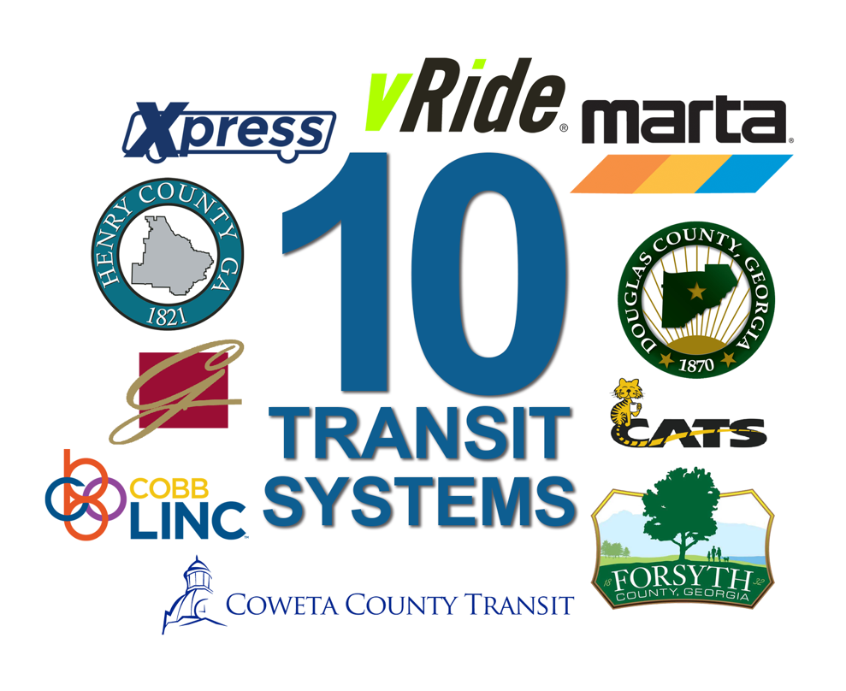
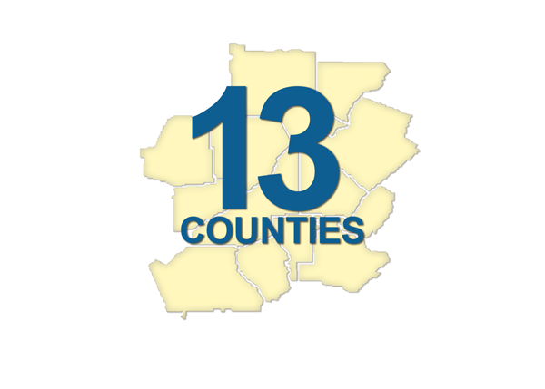
+

Slide 3
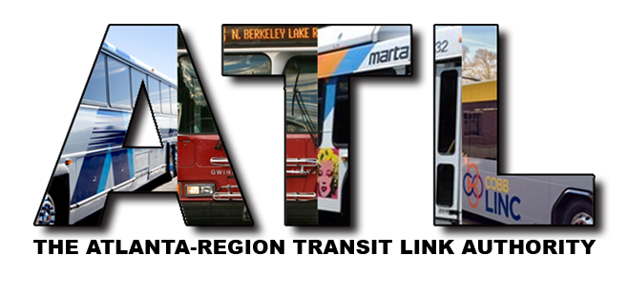
HB 930: Atlanta-region Transit Link Authority (the ‘ATL’)
ATL
Intends to improve coordination, integration and efficiency of transit in Metro Atlanta
HB930 passed the General Assembly on March 29, 2018 and the Governor signed it into law on May 3, 2018, thus creating a new regional governance and funding structure called…
ATL
A unifying entity that ensures coordinated planning and funding of transit across Metro Atlanta
Oversees all transit activity to increase transparency around regional transit planning, funding and operations

Slide 4
ATL
Overview of the ATL
A unifying entity that ensures coordinated planning and funding of transit
Regional Governance
Regional Transit Plan
R
Transit Funding
Regional Unified Branding
Interaction with Existing Transit Operators
Notes:
`

Slide 5
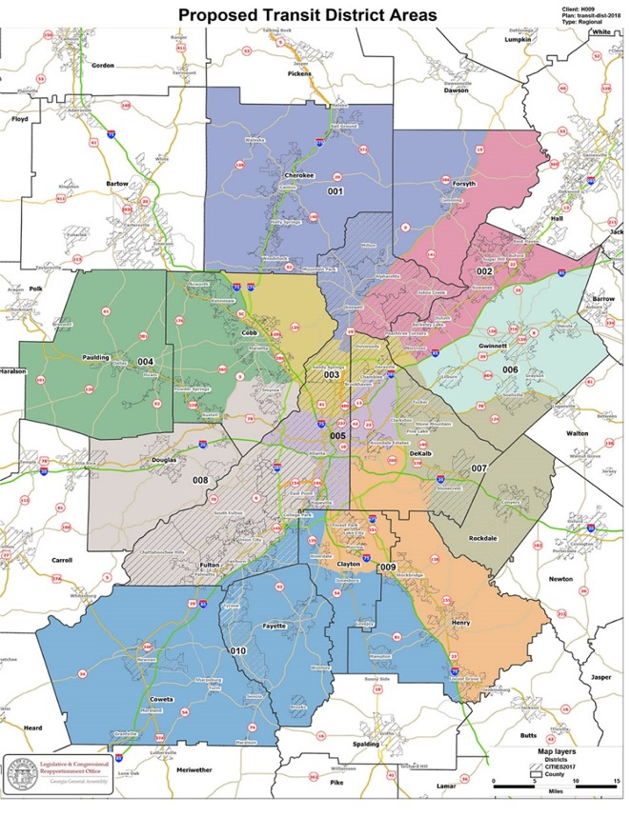
ATL
Regional Governance/ ATL Board Structure
16 members, 4 year terms – Designed for regional thought & approach
State Level Appointees
Governor
Lt. Governor
Speaker
GDOT Commissioner
TOTAL
1 (Chair)
2
2
(Non-voting)*
5*(one third)
Local Level Appointees
Caucus of Legislators, County Commission Chairs & Mayors within Districts
TOTAL
10
10 (two thirds)
Notes:
16-member board to be named by 12/01/2018
Members will serve four-year terms
One citizen representing each of 10 districts drawn within the 13-county region
Each district board member appointed by caucus of state legislators, county commission chairs and mayors within each district
Two appointees by Speaker of the House
Two appointees by Lt. Governor
One Gubernatorial appointee who serves as Chair
GDOT Commissioner (non-voting)

Slide 6
ATL
Regional Governance/ ATL Board Eligibility and Criteria
16 members, 4 year terms – Designed for regional thought & approach
Each district’s board member shall:
Be a resident of the authority district which he or she represents
Possess significant experience or expertise in a field that would be beneficial to the accomplishment of the function and purpose of the authority
Other than GDOT commissioner, no person holding any other “office of profit or trust under the state” shall serve on the board
Local Level Appointees
Be appointed no later than December 1, 2018

Slide 7
ATL
Process for Electing District-based ATL Board Members
10 Transit Districts within the 13-county Region
Two-step process:
1) Mayors in each district meet to select a mayoral representative in the transit district election
2) Transit district election – called by county chair with largest population in district – occurs with three subgroups participating:
State legislators whose districts include any of the transit district
County commission chairs whose counties are part of the transit district
Mayor selected in Step 1 (plus Atlanta Mayor if part of district)

Slide 8
ATL
Suggested Timeline and Procedures for Board Member Elections
Process To Be Completed by December 1, 2018
Step 1 Mayoral Caucus Meetings held during August 2018 – 1 complete; 6 currently scheduled
The designated city in the geographical center of the district hosting each Step 1 Mayoral Caucus
Step 2 Board Member Elections should be held between October 1 and November 16, 2018
The county chair calling for the Step 2 Election meeting will designate the location
ATL Board Member must be elected by majority vote of eligible Electors
ATL must receive certification of each ATL Board Member election after the vote

Slide 9
ATL
Regional Transit Plan
1 of 2 Core Activities
Cherokee
Clayton
Coweta
Cobb
DeKalb
Douglas
Fayette
Forsyth
Fulton
Gwinnett
Henry
Paulding
Rockdale
6-year and 20-year time horizons
Developed in consultation with the region’s Metropolitan Planning Organizations (MPOs)
Coordinate existing and future transit service
ATL
Regional stakeholders, including local governments, may submit requests to the ATL for additions and amendments to the Plan from time to time based on changing conditions
After 1/1/2019, referendum transit projects must be in RTP & approved by the ATL
Notes:
Projects based upon a region-wide approach to the provision of transit services through buses and rail
The establishment of multimodal stations within the jurisdiction of the authority
Enhancement of connectivity throughout the region
Cost-effective expansion of existing transit systems, and
The coordination of schedules and methods of payment for transit service providers

Slide 10
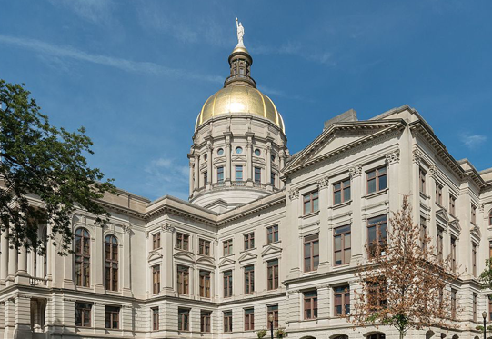
ATL
Regional Transit Funds
2nd Core Activity: Management, Allocation & Generation
Designated Recipient Role
ATL’s Scope: All Federal & State Transit Funds in region
ATL can issue its own bonds and work with other state agencies to issue bonds
Up to 30 year, Up to 1% transit-specific SPLOST

Slide 11
ATL
Regional Unified Branding
R
Intent – a seamless customer experience
At Least 10 Public Transit Agency/Operators
Regional Transit Plan must include plan for the creation of a unified brand to encompass all transit service providers in 13-county region
Metropolitan Atlanta Rapid Transit Authority
Cobb County Department of Transportation
Douglas County Rideshare
State Road & Tollway Authority
Gwinnett County Board of Commissioners
Cherokee County Board of Commissioners
Henry County Transit
Forsyth County Public Transportation Dial A Ride
Coweta County Dial A Ride
vRide and Enterprise Rideshare
As of Jan. 1, 2019, any new MARTA asset worth more than $250,000 must display The ATL logo and brand, prominently featuring the acronym “ATL”
As of Jan. 1, 2023, the ATL logo and brand must be used on any and all MARTA property
ATL issued RFP on Aug. 15, 2018 for branding and communications consulting services

Slide 12
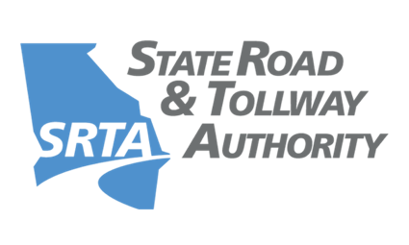
ATL
ATL Interaction with Existing Transit Entities
MARTA – GRTA – SRTA – ARC: Still exist and continue to exist
MARTA has exclusive authority for operating region’s heavy rail system, including any new heavy rail projects
MARTA retains control over its current local funding & operations
MARTA’s legal contractual obligations unaffected
The ATL is administratively attached to GRTA
GRTA and SRTA’s roles in regional transit transitions to ATL by 2020/2021
SRTA’s tolling, GTIB, and transportation financing roles remain intact
ARC & ATL work closely together to revise current regional transit process, and to ensure that Regional Transit Plan aligns and integrates with TIP and STP processes and funding

Slide 13
ATL
The ATL: Regional Opportunities…
…Flow from a Regional Outlook
Notes:
Leverage Technology to mesh existing Transit Services
Explore MaaS to increase seamlessness and improve value – Move from segmented trips to Journeys
Seek out innovative partnerships with Transportation Network Companies to address first mile, last mile and other transit gaps
Plan and adhere to uniform data formats and commit to Open Standards to improve data sharing within the region and with other related Service Providers
Leverage the strengths of existing transit/transportation professionals and reduce redundancies so that collectively we accomplish more with the existing resources we have today
Make it easier for people within Metro Atlanta to go from where they are to where they want or need to be within the Region

Slide 14
Visit Our New ATL Website:
atltransit.ga.gov
THANK YOU!
Scott Haggard
Director of Government and External Affairs, ATL/SRTA
shaggard@srta.ga.gov
678-471-7259

